Slide 1

Full Stack Web Development July 15
Presented by:
Ramadugu Yashwanth
Computer Science and Engineering
Enrollment Number: 21CS002410
Supervisor:
P Abhishek

Slide 2
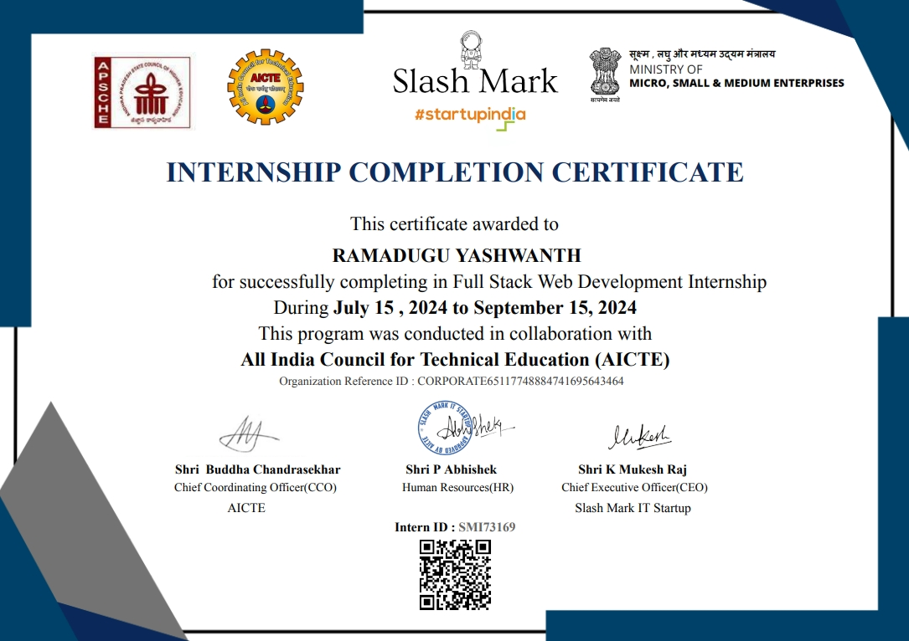
Internship Certificate

Slide 3
Introduction
Slash Mark IT Startup is a forward-thinking company specializing in cutting-edge technology solutions with a focus on innovation in machine learning and AI-driven applications. Established with a mission to empower businesses through intelligent technology, Slash Mark has become a key player in providing personalized user experiences through modern IT solutions, especially in areas like recommendation systems and data-driven insights.
Overview of the Internship Program: The Machine Learning internship at Slash Mark IT Startup, conducted in collaboration with the All India Council for Technical Education (AICTE), offered me a hands-on opportunity to explore the intricacies of machine learning models in the context of real-world applications. Over the course of the internship, I worked on developing and fine-tuning a music recommendation system, applying advanced algorithms to build personalized music suggestions for users based on their preferences and behavior.
Internship Importance: This internship was highly instrumental in refining my skills in machine learning, especially in the domain of recommendation systems. The project I worked on involved leveraging collaborative filtering, content-based filtering, and hybrid models to create a dynamic system capable of recommending songs that align with individual user preferences. Music recommendation systems play a pivotal role in the entertainment industry, powering platforms like Spotify, YouTube, and Apple Music, enhancing user engagement and satisfaction. The knowledge I gained from this project has practical applications in building intelligent systems that can predict user behavior, offer personalized experiences, and drive business outcomes in media and beyond.

Slide 4
Internship Objectives
Duration: 2 Months (July 15 – September 15, 2024)
Location: Remote
Internship Type: Part Time
Company's Expectations: Slash Mark IT Startup expected me to gain a strong foundation in building recommendation systems using machine learning techniques, focusing on collaborative filtering, content-based filtering, and hybrid models. The aim was to apply theoretical knowledge in developing a system capable of predicting and suggesting music based on user preferences.
Internship Objective: The objective of this internship was to gain practical experience in machine learning and recommendation systems, while improving my technical and analytical skills. By working on a real-world project, I aimed to understand the challenges involved in personalizing user experiences and to build a foundation for a future career as a machine learning engineer.

Slide 5
Key Project & Responsibilities Brief Description
Project: Food Delivery web
Description: This full-stack web development project involves the creation of a comprehensive food delivery platform. The system allows users to browse local restaurants, view menus, place orders, and track deliveries in real-time. It includes features for both users and restaurant owners, ensuring seamless interaction from order placement to fulfillment.
Responsibilities:
Designed and developed the front-end interface using HTML, CSS, and JavaScript to create a user-friendly and responsive platform.
Implemented the back-end server using Node.js and Express.js, managing API routes for seamless user interactions and order processing.
Built and maintained a MongoDB database to store restaurant data, user profiles, menus, orders, and delivery details.
Integrated third-party APIs for secure payment processing, real-time delivery tracking, and geolocation services.

Slide 6
Your Roles and Responsibilities
Led the development of the front-end using HTML, CSS, and JavaScript, ensuring an intuitive and responsive user interface for seamless customer experience.
Built and managed the back-end with Node.js and Express.js, handling server-side logic, API endpoints, and user requests efficiently.
Designed and optimized a Firebase database to store and manage restaurant information, user accounts, orders, and delivery data.
Integrated payment gateways and geolocation APIs to enable secure transactions and real-time tracking of food deliveries.
Role: Full stack web Intern
Responsibilities:

Slide 7
Tools used
Front-end: HTML, CSS, JavaScript, React.js
Back-end: Node.js, Express.js
Database: Firebase
List Of Skills
Full Stack Web Development
Front-end Development (HTML, CSS, JavaScript)
Back-end Development (Node.js, Express.js)
Database Management (Firebase)
API Integration and Development

Slide 8
Outcomes/results
Successfully developed a fully functional food delivery platform that allows users to browse restaurants, view menus, place orders, and track deliveries in real-time.
Achieved seamless user experience with a responsive front-end interface, leading to improved user engagement and satisfaction.
Integrated secure payment processing and real-time delivery tracking, ensuring a smooth and trustworthy transaction process.
Optimized back-end performance to handle multiple user requests simultaneously, improving overall system efficiency and scalability.

Slide 9
Project Description
Developed a full-stack web application for food delivery, allowing users to browse restaurants, view menus, place orders, and track deliveries in real-time. The platform was built using Node.js and Express.js for the back-end, MongoDB for database management, and React.js for a responsive front-end. Key features include secure payment integration, geolocation-based delivery tracking, and user authentication via JWT. The application was deployed on cloud hosting platforms, ensuring high performance and scalability.
Focus on Impact
The food delivery platform significantly enhanced customer experience by providing an intuitive interface for browsing menus, placing orders, and tracking deliveries in real-time. This streamlined process not only improved user satisfaction but also increased engagement with the service. Operational efficiency was markedly improved as the platform automated order management and delivery tracking, reducing manual errors and streamlining restaurant operations. Additionally, the platform’s accessibility across devices allowed users to conveniently order food from their preferred restaurants, regardless of location. Deployed on cloud hosting, the solution ensured scalability to accommodate varying traffic loads and support future growth, making it a robust and adaptable solution for both users and restaurant partners.

Slide 10
Key Achievements/Outcomes
User Experience Enhancement: Successfully created a responsive and intuitive interface that streamlined the food ordering process, leading to increased user engagement and satisfaction.
Operational Efficiency: Automated order management and delivery tracking, resulting in a reduction of manual errors and improved operational efficiency for restaurant partners.
Real-Time Tracking: Integrated real-time delivery tracking and secure payment processing, enhancing the reliability and convenience of the platform for users.
Scalability: Deployed the application on cloud hosting platforms, ensuring high performance and scalability to handle varying traffic loads and support future expansion.
Positive User Feedback: Received positive feedback from users for the platform’s ease of use and reliable service, contributing to a successful launch and adoption.

Slide 11
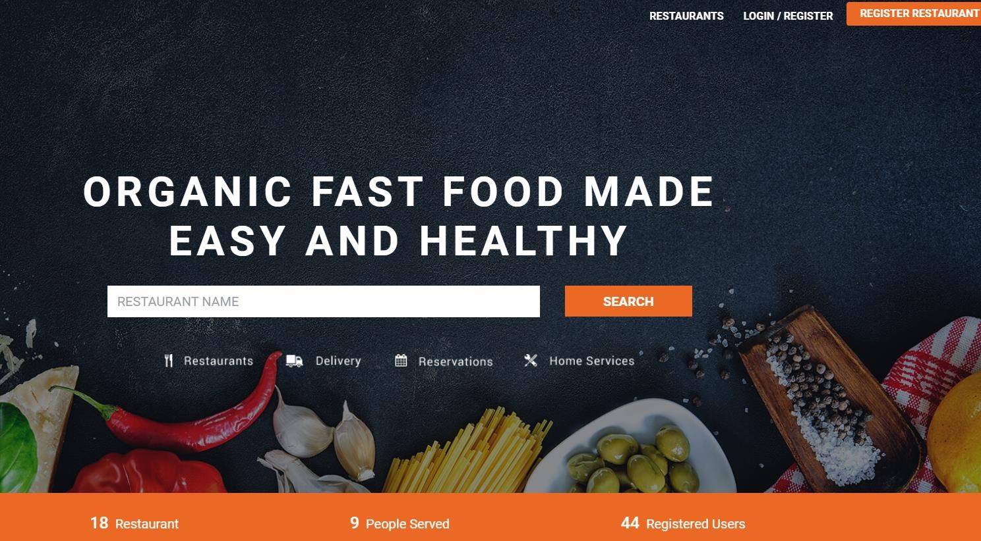

VISUALS

Slide 12
Lessons Learned:
Importance of User Feedback: Regular feedback from users during development helped refine the user interface and functionality, ensuring the platform met real-world needs and expectations.
Scalability Considerations: Designing with scalability in mind from the start was crucial for handling increasing user traffic and ensuring long-term performance.
Integration Complexity: Successfully integrating multiple APIs (payment gateways, geolocation) highlighted the importance of thorough testing and seamless integration for a smooth user experience.
Challenges Overcome:
Real-Time Tracking: Implemented effective real-time delivery tracking despite challenges with integrating geolocation services, improving user satisfaction and transparency.
Database Management: Addressed performance issues with MongoDB by optimizing queries and indexing, ensuring fast and reliable data retrieval.
.

Slide 13
Key Takeaways
User-Centered Design: Prioritizing user experience and feedback led to a more intuitive and effective platform, demonstrating the value of continuous user involvement in the development process.
Scalable Architecture: Planning for scalability from the beginning ensured the application could handle increased traffic and grow with the business, emphasizing the importance of scalable design.
Effective API Integration: Successfully integrating diverse APIs (payment, geolocation) highlighted the necessity for thorough testing and seamless integration to enhance functionality.
Data Management: Optimizing database performance through indexing and efficient queries improved data handling, showcasing the importance of effective database management.

Slide 14
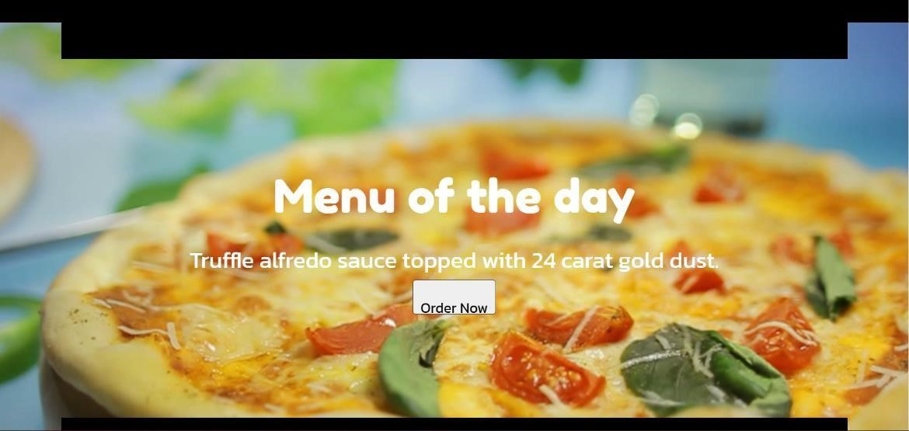
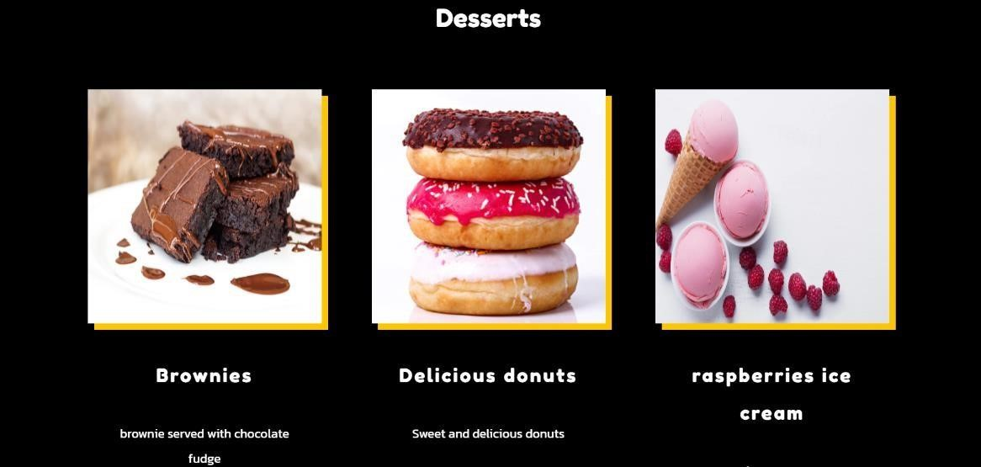
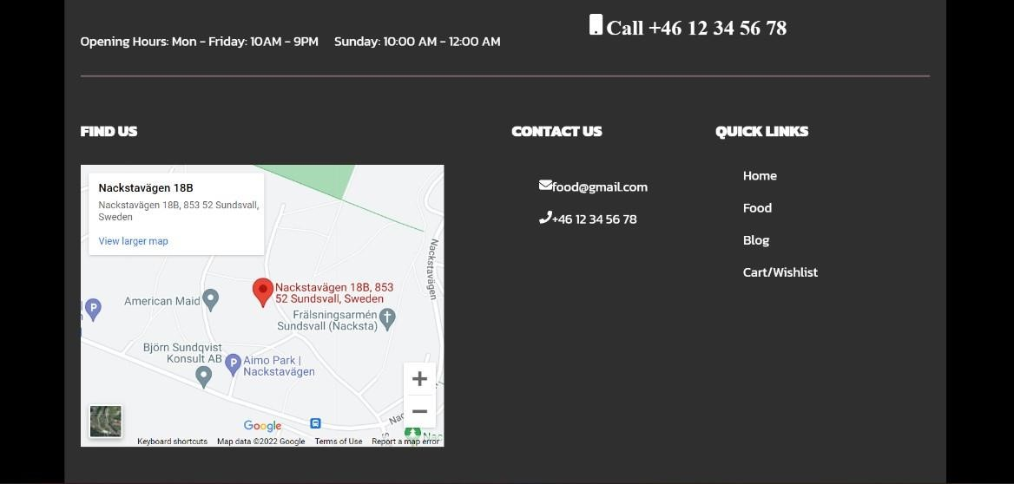
Conclusion and Results

Slide 15
Future Work
Feature Expansion: Plan to add new features such as personalized recommendations, user reviews, and loyalty programs to enhance the user experience and increase engagement.
Performance Optimization: Explore further optimizations for database queries and server performance to handle larger volumes of traffic and improve response times.
Mobile Application: Develop a dedicated mobile app to provide a seamless experience across devices and capitalize on mobile user engagement.
Advanced Analytics: Integrate advanced analytics to track user behavior and preferences, enabling more targeted marketing and operational improvements.
AI Integration: Consider incorporating AI for smarter order predictions, dynamic pricing, and automated customer support to enhance the platform’s functionality and efficiency.

Slide 16
Mentor Contact Information
Mentor / Coordinator :- P Abhishek
Email :- hr.slashmark@gmail.com
FullStack web development.
Address :- NewDelhi,India.

